Slide 1
Battle of THE NeIGHBORHOODS
Sienna Spiglanin

Slide 2
Introduction and Business Problem
A business owner is interested in opening a new restaurant in the United States. They want to know which is the best neighborhood to open it in. The criteria they are concerned with in defining the best neighborhood includes;
Per Capita Income
Location Population
Population Density
Neighborhood Venues
We must suggest the best neighborhood to build this new restaurant.

Slide 3
DATA
We will get our information from the following sources:
List of all the cities in United States with Per Capita Income: https://en.wikipedia.org/wiki/List_of_United_States_counties_by_per_capita_income
List of all the cities in United States with population density and coordinates: https://en.wikipedia.org/wiki/List_of_United_States_cities_by_population
From Four Square API, we will obtain:
List of all venues in each neighborhood of the selected city
List of all venues in each city

Slide 4
METHODOLOGY
In order to perform the analysis and suggest the best location, the following are the steps we will follow:
The data from the Wikipedia pages https://en.wikipedia.org/wiki/List_of_United_States_cities_by_population and https://en.wikipedia.org/wiki/List_of_United_States_counties_by_per_capita_income was collected and scraped using the BeautifulSoup library to build pandas data frames listing the cities, states, latitude and longitude coordinates, area, population density and income per capita. The data frames were cleaned and processed appropriately.
The FourSquare API was then used to call the venues in each U.S. city, based on each venue’s category. We’ve assigned weights to each category based on stakeholder indication to get the city with the maximum weight.
Then, we use K means to cluster the venues based on their category and get the coordinates of the cluster with the maximum weight. This is the preferred location to build a new restaurant.

Slide 5
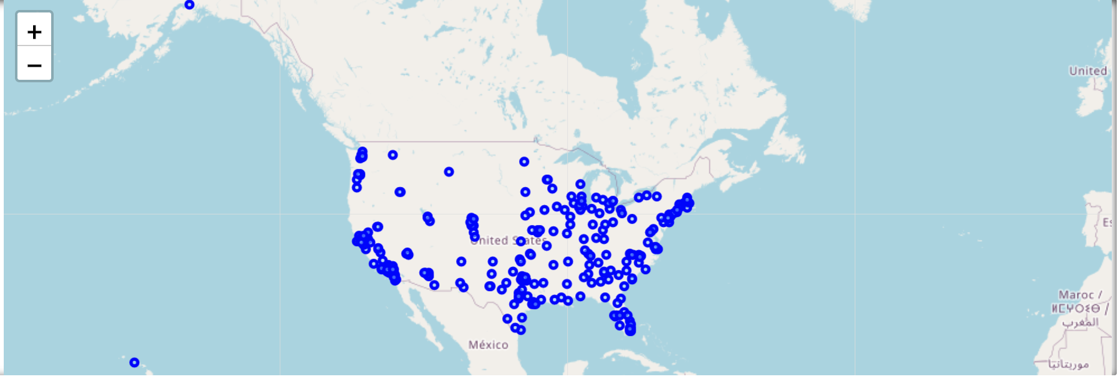
Plot of ALL U.S. CITIES EXTRACTED
The blue dots indicate the United States city locations extracted.

Slide 6
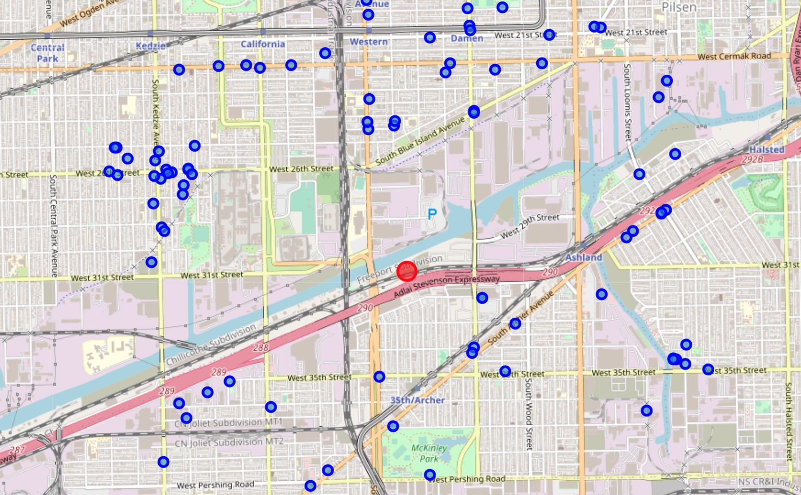
MAP OF CHICAGO VENUES
Based on the constraints we chose, we found that Chicago, Illinois would be the best city to build a new restaurant.

Slide 7
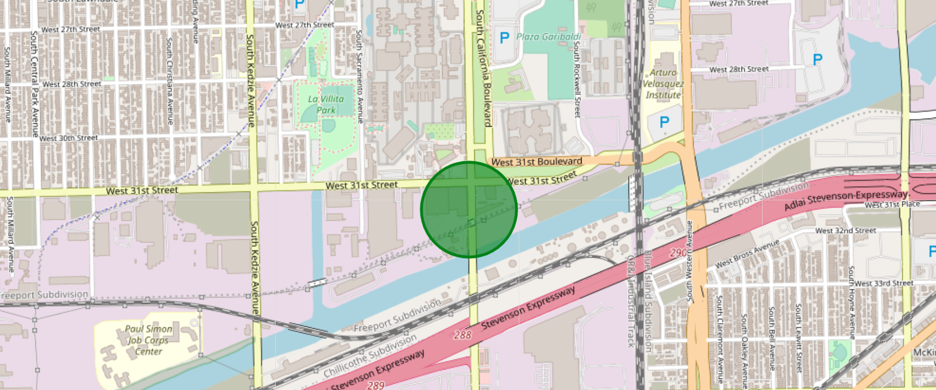
Results
The circle indicates the best place to build a new restaurant in Chicago

Slide 8
Recommendations
In the Four Square API, we’ve queried the venues of a city by specifying a LIMIT and radius. Since using a free Four Square account allows for less API call, we’ve chosen a lower LIMIT. For more accurate results, we can
Increase the LIMIT.
Increase the Radius to yield more venue results.
In the venue categories, we’re only choosing a few to give weights and identify the best cluster. Weights must be assigned relatively for each venue category. Then, considering more venue categories would yield an even better output.

